Slide 1

Weather trend
My findings on weather anomalies and trend

Slide 2
Summary
This analysis calculates the weather anomaly for Los Angeles.
I will be explaining my findings on minimum, maximum and mean temperature in the mid-century of 1945 to 1955 and my comparison with year 2022.
Weather anomaly between 2022 and mid-20th century.
Showing weather trend with graphs.
Conclusion based on my findings.

Slide 3


Weather in the Mid-century (1945-1955)
The data used for this analysis is the daily minimum and maximum temperatures for Los Angeles, Downtown from the year 1945 to 1955.
The average minimum temperature from 1945 to 1955 is . As the data is recorded in tenths of Degree Celsius, the average minimum degree Celsius will be 12.3 degree Celsius, rounded to 1 decimal place.
The average maximum temperature from 1945 to 1955 is . As the data is recorded in tenths of Degree Celsius, the average maximum degree Celsius will be 23.0 degree Celsius, rounded to 1 decimal place.
Given the maximum, minimum temperature from 1945 to 1955, the average temperature being calculated is by average max temperature + average min temperature / 2. The average temperature is . As the data is recorded in tenths of Degree Celsius, the average Degree Celsius will be 17.6 degree Celsius, rounded to 1 decimal place.

Slide 4
Weather in 2022
The data used for this analysis is the daily minimum and maximum temperatures for Los Angeles, Downtown from the year 2022.
The average minimum temperature for 2022 is . As the data is recorded in tenths of degree Celsius, the Degree Celsius would be 13.7 degree Celsius, rounded to 1 decimal place.
The average maximum temperature for 2022 is . As the data is recorded in tenths of degree Celsius, the Degree Celsius would be 23.6 degree Celsius, rounded to 1 decimal place.
Given the maximum, minimum temperature for 2022, the average temperature being calculated is by average max temperature + average min temperature / 2. The average temperature is . As the data is recorded in tenths of degree Celsius, the average Degree Celsius would be 18.6 Degree Celsius, rounded to 1 decimal place.

Slide 5

Findings
Weather anomaly is based on the temperature from 2022 minus the average mid-century temperature (1945 – 1955).
Based on my findings, the weather anomaly for minimum temperature is 1.4 Degree Celsius.
For maximum temperature, the anomaly is 0.6 Degree Celsius.
And the average temperature anomaly is . Rounded to 1 decimal place and in Degree Celsius, the average temperature anomaly is 1.0 Degree Celsius.
In addition to the temperature anomaly, it is also worth noting that the trend shown in the graph on slide 7, indicates a consistent increase in both minimum and maximum temperatures over the past several decades.

Slide 6
Findings
This is consistent with previous research that suggest that global warming is leading to an increase in both minimum and maximum temperatures.
This trend is particularly evident in the minimum temperature data, which has shown a steady increase from 1925 to 2022, as well as the minimum temperature anomaly of 1.4 Degree Celsius comparing 2022 to mid-20th century.

Slide 7
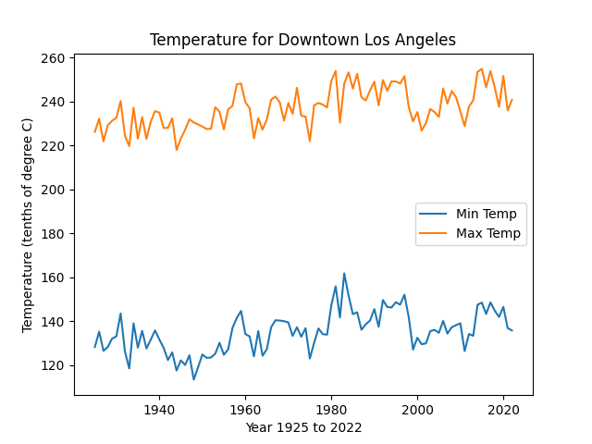
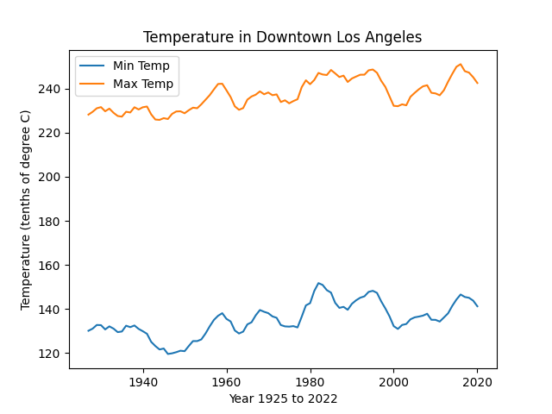
Graph
By smoothing the graph over a 5-year period, it will help to remove outliers and reduce fluctuations shown in the graph (right). This helps in showing an upward trend in temperature for both minimum and maximum temperature as shown in the graph on the right.

Slide 8
Findings
In the graph, both minimum and maximum temperature are showing higher highs and higher lows, which shows an uptrend in temperature.
It is however important to note that the data used in this analysis is based on a single weather station in Los Angeles and may not be representative of broader climate trends in the region.
However, the consistency of the trends shown in the data suggest that these findings are likely to be broadly applicable.

Slide 9
Conclusion
Overall, these findings highlight that there is an upward trend in the weather, creating higher levels of temperature.
The minimum temperature data especially, is pushing the average up to 1 Degree Celsius.
The data suggest that without intervention from governments all around the world, the trend is likely to continue in an upward trajectory.
These findings give reason for governments all around the world to push for renewable energy, like solar panels, wind and water turbine.
And be less reliant on natural resources, like oil and gas, that produces carbon dioxide which affects our earth’s atmosphere.

